Slide 1
SOF 103
C and C++ Programming
Chapter 7
Library Functions
a.k.a: Built-in Functions or Pre-defined Functions

Slide 2
Vision and Mission
Vision
Xiamen University Malaysia aspires to become a university with a distinct global outlook, featuring first-class teaching and research, and embracing cultural diversity.
Mission
To nurture young talents with dignity and wisdom, turning them into fine citizens of the region who will contribute to the prosperity of the people and social progress of Malaysia, China and Southeast Asia.
Compile by Dr. Hew

Slide 3
Chapter Overview
Function in C++
#include <cmath>
#include <cstdlib>, #include <ctime>
#include <cstring>
#include <cctype>
4/5/2022

Slide 4
Function
Function is a block of code that has been organized into a separate unit and given a name.
The act of using the name to invoke a code is known as calling that function.
To specify a function call in C++, you write the name of the function, followed by a list of expressions enclosed in parentheses. These expressions, called arguments, allows the calling program to pass information to the function.

Slide 5
Function (Continued)
Once called, the function takes the data supplied as arguments, does its works, and then returns to the program at the point in the code from which the call was made.
The operation of going back to the calling program is called returning from the function.
As it returns, a function often passes a value back to its caller. This operation is called returning a value.

Slide 6
Functions in C++
Two types of function in C++:
  Functions from C++ standard library
  User-defined function (will be discussed in more details next lesson)
The C++ standard library provides a rich collection of functions for performing common mathematical calculations (cmath), string manipulations (cstring), character manipulations, input/output, error checking, and many other useful operations.

Slide 7
Math Library Functions
(#include <cmath>)
Function | Description | Example
ceil(x) | Rounds x to the smallest integer not less than x | ceil(9.2) is 10.0 ceil(−9.8) is −9.0
cos(x) | Trigonometric cosine of x (x in radians) | cos(0.0) is 1.0
exp(x) | Exponential function e^{x}. | exp(1.0) is 2.71828 exp(2.0) is 7.38906
fabs(x) | Absolute value of x | If x > 0 then abs(x) is x If x = 0 then abs(x) is 0 If x < 0 then abs(x) is −x

Slide 8
Math Library Functions
(#include <cmath>)
Function | Description | Example
floor(x) | Rounds x to the largest integer not greater than x | floor(9.2) is 9.0 floor(-9.8) is -10.0
fmod(x, y) | Remainder of x/y as a floating point number | fmod(13.657, 2.333) is 1.992
log(x) | Natural logarithm of x (base e) | log(2.71828) is 1.0 log(7.38905) is 2.0
log10(x) | Logarithm of x (base 10) | log10(10.0) is 1.0 log10(100.0) is 2.0

Slide 9
Math Library Functions
#include <cmath>
Function | Description | Example
pow(x, y) | X raised to the power of y (x^{y}) | pow(2, 7) is 128 pow(9, .5) is 3
sin(x) | Trigonometric sine of x (x in radians) | sin(0.0) is 0
sqrt(x) | Square root of x | sqrt(900.0) is 30.0 sqrt(9.0) is 3.0
tan(x) | Trigonometric tangent of x (x in radians) | tan(0.0) is 0

Slide 10
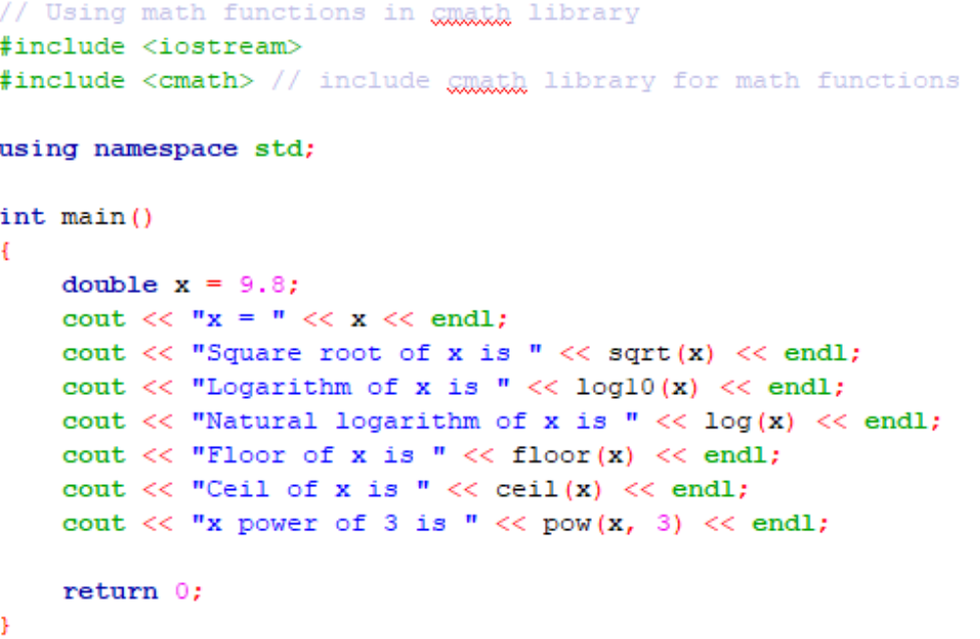
Example using math functions in cmath library

Slide 11
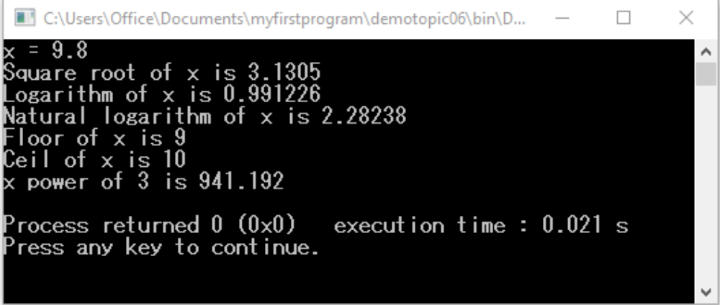
Output of math functions program

Slide 12
Standard library
#include <cstdlib>
Function | Description
rand() | Generates a pseudo-random integer between 0 and RAND_MAX. The symbolic constant RAND_MAX must be at least 32767.
srand(i) | Takes an unsigned integer i as argument and seeds the rand function to produce a different sequence of random numbers for each execution of the program

Slide 13
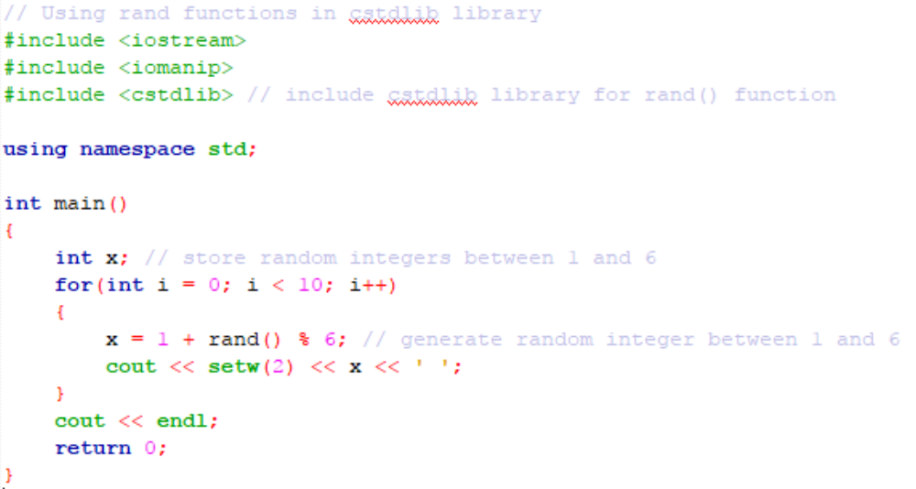
Example of a random number generator program using rand()

Slide 14
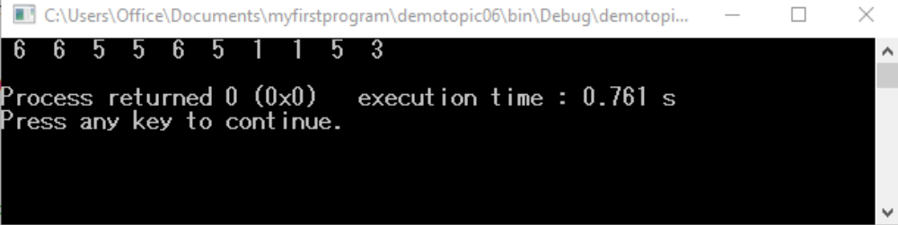
Output of a random number generator program
This program has one shortcoming, i.e. the random numbers are the same every time you execute the program.
To overcome this problem, we use the function srand() in the next example.

Slide 15
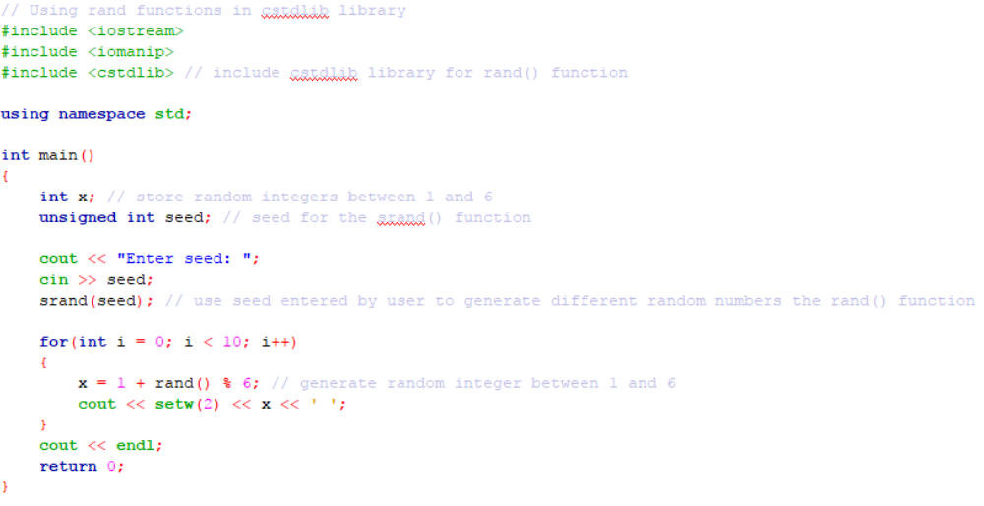
Example of using srand() and rand() to generate different random numbers

Slide 16
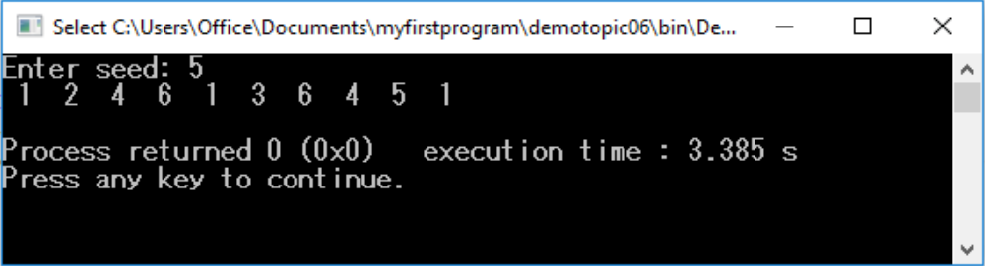
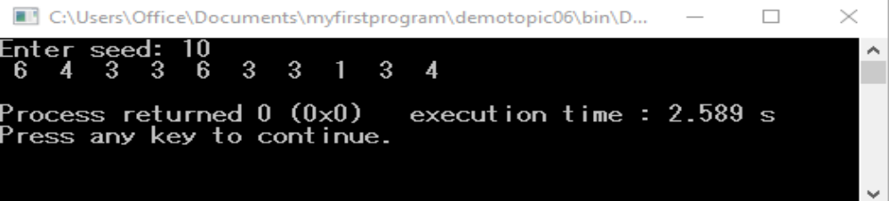
Output of the srand() and rand() example program
The set of random numbers are different for each seed number entered.

Slide 17
Improving random number generator using the function time()
The previous program has one problem, i.e. the user needs to provide a seed integer to generate a different set of random numbers.
To solve this problem, we let the computer provide the seed using the function time() from the ctime library.
The function time() returns the current “calendar time” in seconds. This value is converted to unsigned integer and used as the seed to the random number generator.
Example is shown in the next slide.

Slide 18
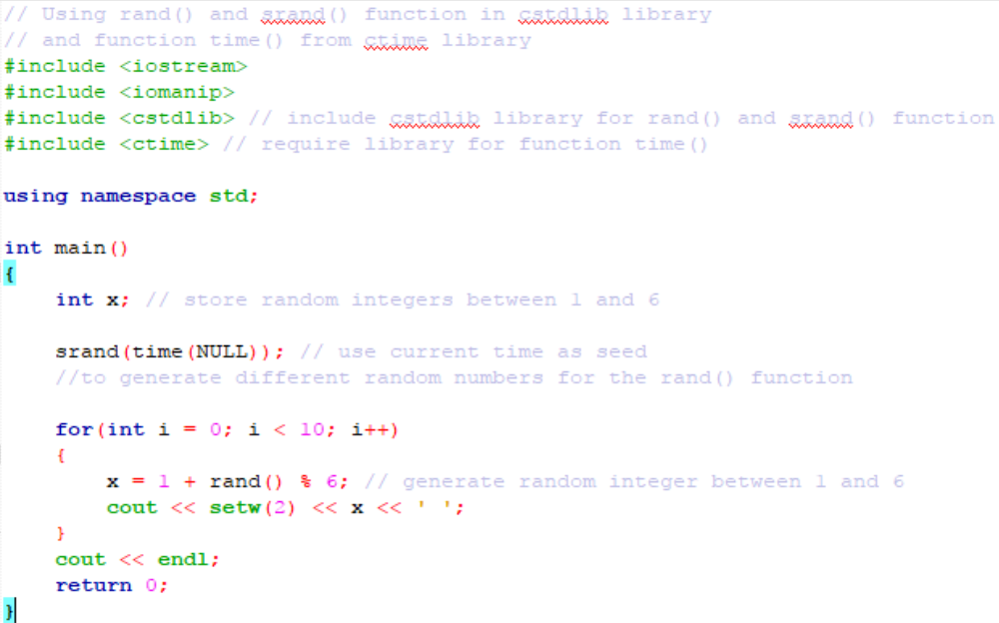

Example of using function time() to seed the function srand()

Slide 19
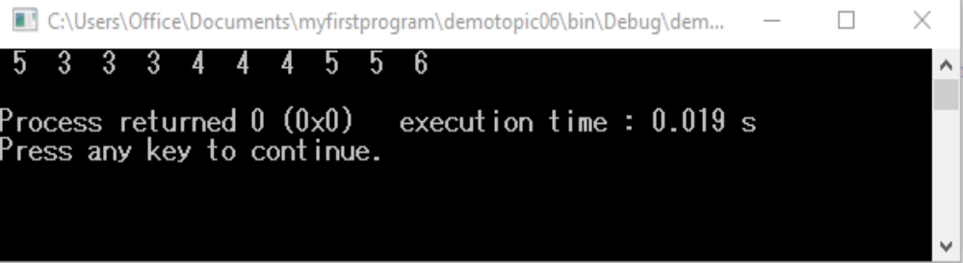
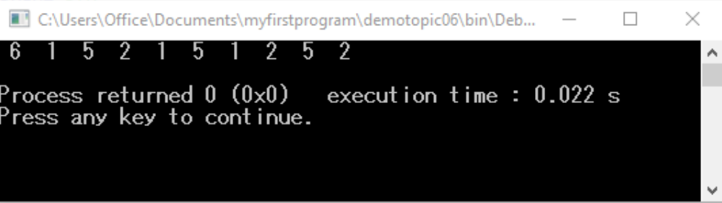
Output of the random number generator program with function time(NULL)
The set of random number generated are different at each program execution.

Slide 20
String conversion functions in <cstdlib> library
There are functions in the general utilities library <cstdlib> that convert strings of digits to integer and floating-point values.
Prototype | Description
double atof(const char *nPtr) | Converts the string nPtr to float.
int atoi(const char *nPtr) | Converts the string nPtr to int.
long atol(const char *nPtr) | Converts the string nPtr to long int.

Slide 21
String conversion functions in <cstdlib> library
Prototype | Description
double strtod(const char *nPtr, char **endPtr) | Converts the string nPtr to double.
long strtol(const char *nPtr, char **endPtr, int base) | Converts the string nPtr to long.
unsigned long strtoul(const char *nPtr, char **endPtr, int base) | Converts the string nPtr to unsigned long.

Slide 22
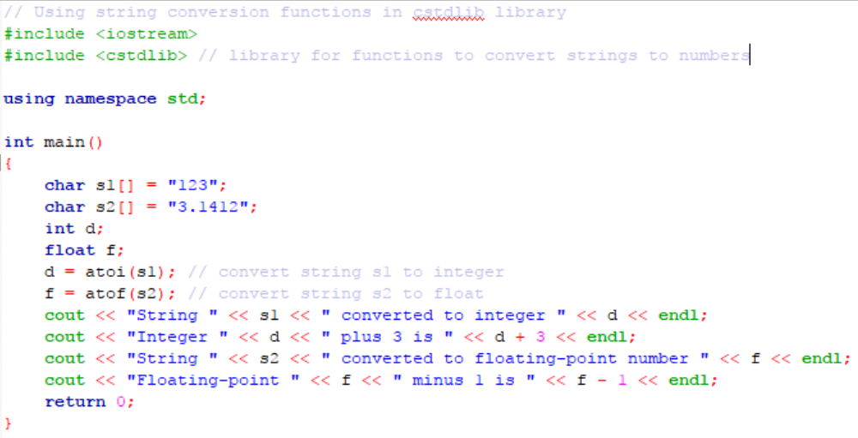
Example of string conversions to integer and double

Slide 23
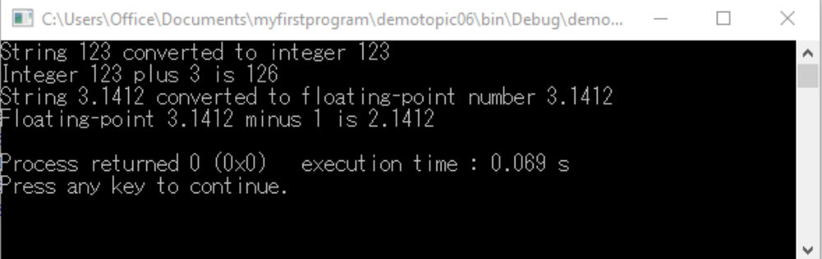
Output of the string conversion program

Slide 24
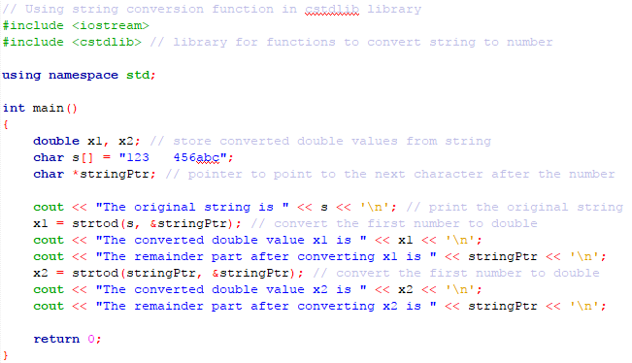
Example using strtod function

Slide 25
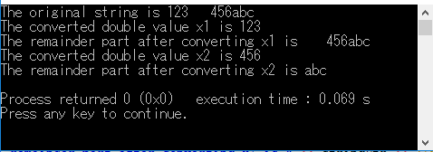
Output of program using strtod function

Slide 26
String Manipulation Functions in the String Handling Library
#include <cstring>
Function prototype | Function description
char *strcpy(char *s1, const char *s2) | Copies the string s2 into the character array s1. The value of s1 is returned.
char *strncpy(char *s1, const char *s2, size_t n) | Copies at most n characters of the string s2 into the character array s1. The value of s1 is returned.
char *strcat(char *s1, const char *s2) | Appends the string s2 into the string s1. The first character of s2 overwrites the terminating null character of s1. The value of s1 is returned.

Slide 27
String Manipulation Functions in the String Handling Library
#include <cstring>
Function prototype | Function description
int strcmp(const char *s1, const char *s2) | Compares the string s1 to the string s2. The function returns a value of 0, less than 0, or greater than 0 if s1 is equal to, less than, or greater than s2, respectively.
int strncmp(const char *s1, const char *s2, size_t n) | Compares up to n characters of the string s1 to the string s2. The function returns a value of 0, less than 0, or greater than 0 if s1 is equal to, less than, or greater than s2, respectively.

Slide 28
Splitting a String into Substrings
(strtok)
Function prototype | Function description
char *strtok(char *s1, const char *s2) | A sequence of calls to strtok breaks string s1 into “tokens” – logical pieces such as words in a line of text – separated by characters contained in string s2. At the first invocation. The first s2 will be found and replaced by \0. The return pointer stores the address of the first token(s1). The location of the first non s2 character right after the first s2 is recorded internally in the function for future uses. At subsequent invocation. S1 should be nullptr. The internally recorded starting point is automatically used as the starting point. The next s2 is replaced by \0. The return pointer stores the address of the current token(which is the starting location internally stored before this invocation).

Slide 29
String Manipulation Functions in the String Handling Library
#include <cstring>
Function prototype | Function description
char *strchr(char *s1, int c) char *strstr(char *s1, const char *s2) | Find the location of a character in a string. It returns the address of the first occurrence of character in the C string s1. If the character does not exist, it returns nullptr. Search for a substring. Returns the address of the first occurrence of s2 in s1, or a null pointer if s2 is not part of s1.

Slide 30
String Manipulation Functions in the String Handling Library
#include <cstring>
Function prototype | Function description
size_t strlen(const char *s) | Determines the length of string s. The number of characters preceding the terminating null character is returned.
Note: size_t is an integer data type similar to int, long or short.

Slide 31
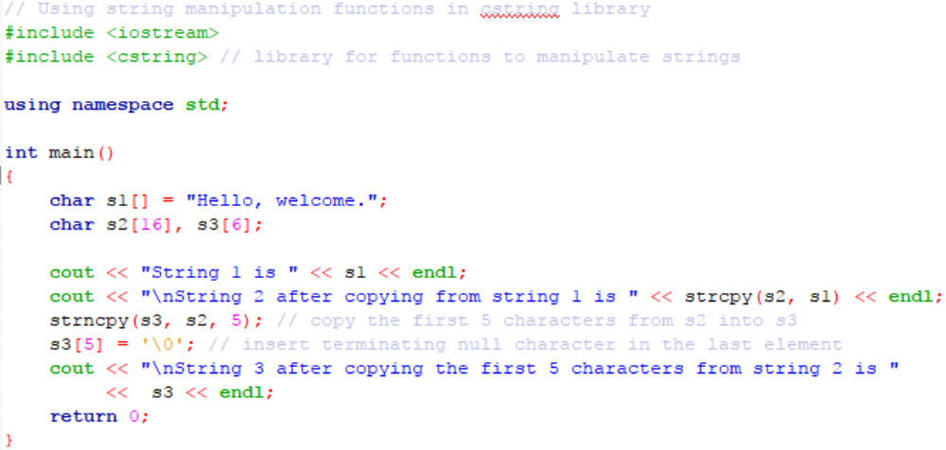
Example of copying string into another string

Slide 32
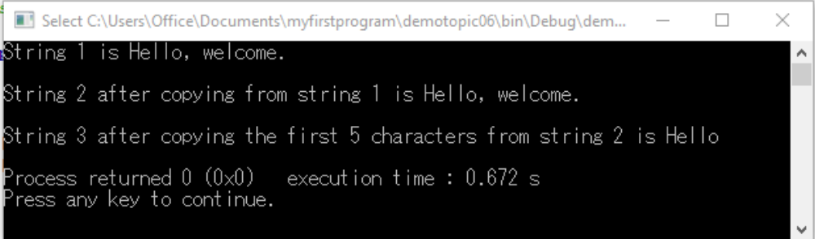
Output of copying string program

Slide 33
Character Handling Library
#include <cctype>
The character handling library includes several function that perform useful tests and manipulations of character data.
Each function receives a character – represented as an int or EOF as an argument.
Characters are often manipulated as integers.
The EOF normally has a value of −1.

Slide 34
Character Handling Library
#include <cctype>
Prototype | Description
int isdigit(int c) | Returns true if c is a digit, and false otherwise.
int isalpha(int c) | Returns true if c is a letter, and false otherwise.
int isalnum(int c) | Returns true if c is a digit or a letter, and false otherwise.
int islower(int c) | Returns true if c is a lowercase letter, and false otherwise.

Slide 35
Character Handling Library
#include <cctype>
Prototype | Description
int isupper(int c) | Returns true if c is an uppercase letter, false otherwise.
int tolower(int c) | If c is an uppercase letter, tolower returns c as a lowercase letter. Otherwise, tolower returns the argument unchanged.

Slide 36
Character Handling Library
#include <cctype>
Prototype | Description
int toupper(int c) | If c is an lowercase letter, toupper returns c as a uppercase letter. Otherwise, toupper returns the argument unchanged.
int isspace(int c) | Returns true if c is a white-space character – newline (‘\n’), space (‘ ‘), formfeed (‘\f’), carriage return (‘\r’), horizontal tab (‘\t’), or vertical tab (‘\v’) – and false otherwise.

Slide 37
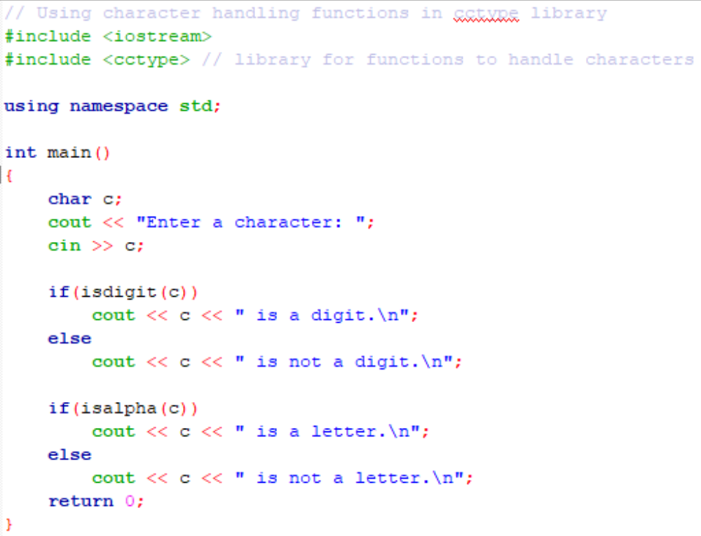
Example of using character handling functions

Slide 38
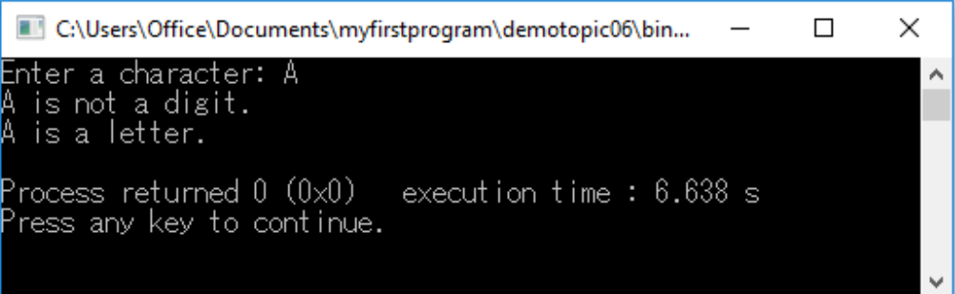
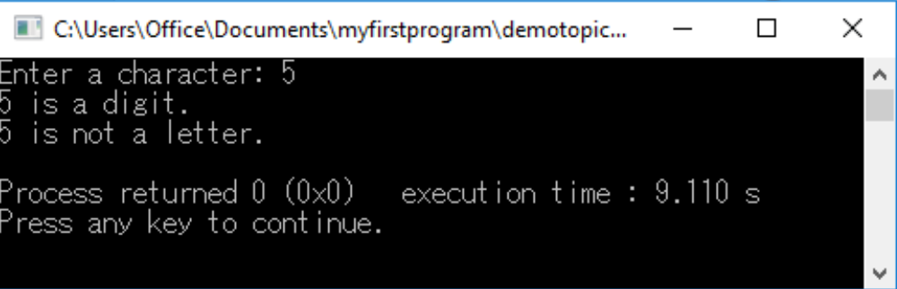
Outputs of the example program for the character handling functions

Slide 39
Programmer-defined Functions
Not all useful functions are provided by C++. In many situations, programmers have to write their own functions for specific applications.
Programmer defined functions must be declared in the form of function prototypes and then defined before they are called by the calling functions.

Slide 40
Function prototype
A function prototype tells the compiler the name of the function, the type of data returned by the function, the number of parameters the function expects to receive, the types of the parameters and the order which theses parameters are expected.
For example, the function prototype
double compute(int a, int b, int c);
tells the compiler the function named compute takes in three int data type parameters in its arguments and returns a double data.

Slide 41
Function prototype (Continued)
Not all functions are required to return a value.
If there is no data returned from a function, then the return type is declared as void.
For example,
void printResult(int a, float b);
declares a function named printResult with two arguments, the first is an int data type and the second is a float data type, and returns no data.

Slide 42
Defining a function
A function definition has the following syntax:
type name(parameters) {
... body ...
}
For example,
int average(int a, int b) {
// expressions
}

Slide 43
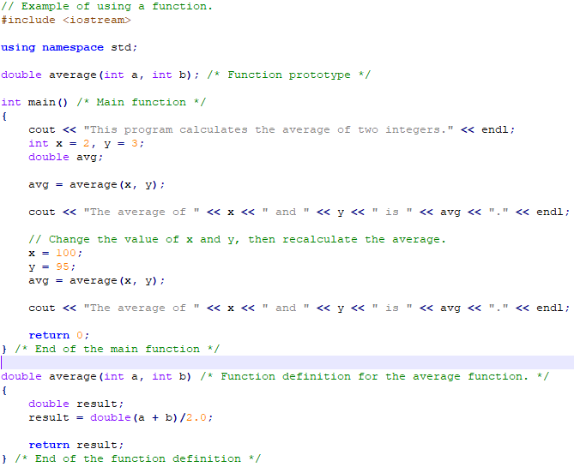
Example of using a function

Slide 44
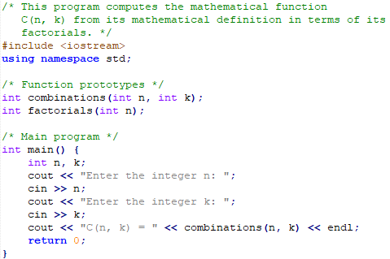
Another example of using functions

Slide 45
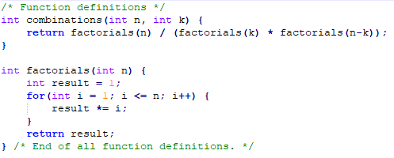
Another example of using functions (Continued)

Slide 46
References
Problem Solving with C++ (10th Edition), Walter Savitch, Addison Wesley, 2018
https://www.programiz.com/cpp-programming
Turbo C programming for the PC, Robert Lafore
Dr.Kamran’s notes
https://www.youtube.com/c/Codearchery

